Slide 1
CS 250 Lecture 31 – Memory hierarchy
2017.11.01
We Can Remember It for You Wholesale
by Philip K. Dick
Appeared in the April 1966 edition of
The Magazine of Fantasy and Science Fiction

Slide 2
Why a hierarchy? Hardware reasons
Memory technologies have widely varying
Access times (usually quite complex to describe)
Cost per bit
Density (bits/per unit volume)
Power consumption
Et cetera, et cetera, et cetera
No one technology can truly satisfy even two of the three memory goals: Fast Cheap Large

Slide 3
Why a hierarchy? Software reasons
During long intervals, meaning “for many, many CPU clock cycles” a program typically will access only a small fraction of its instructions and data
This tendency is called program locality
Program locality has two dimensions
Space, or the range accessed addresses, and
Time – “for the next N clock cycles”
If a program “locality” fits in a small but fast memory, then, for a while, fetch and store are FAST

Slide 4
90/10 Program Locality Rule
For many programs, about 90% of the instructions executed dynamically, that is, about 90% of the instructions appearing in the program execution trace, come from just 10% of the program source code
So a fast, small, thus affordable cache memory need only contain about 10% of a program to deliver fast performance on 90% of the executed instructions of a program
Gene Amdahl says “I’m lovin’ it! 💝 ”

Slide 5
Memory hierarchy concept
Build multiple levels of memory spanning a wide range of speeds (costs) and sizes
Each level maps addresses from a slower, larger memory to a smaller, faster memory higher in the hierarchy
Goal: average cost almost as low as the per bit cost of the cheapest level, yet an average speed almost as fast as the fastest level
Goal can be achieved much of the time because of Program Locality of Reference
We can remember it, wholesale
Notes:
In the first bullet, why are speed and cost shown as synonyms? Because people pay for performance. Memory is priced mostly on speed and not so much on cost of manufacture.

Slide 6
Portrait of the memory hierarchy
Register file
L1 (level 1) cache
L2 cache
L3 cache
Main memory
Disk(s) and/or SSD
Remote storage – remote in time
and/or location (e.g., the “Cloud”)
Movement of bits between registers and L1 is by LOAD/STORE instructions
← Part of the processor circuit
← Top of hierarchy accessed by fetch and by LOAD/STORE instructions
Movement of bits between these hierarchy levels is managed entirely by hardware
← Slower than L1, larger, cheaper
← Slower than L2, larger, cheaper
← Lowest level accessed indirectly by fetch or LOAD/STORE
Movement of bits in/out of this level managed by Operating System
← Permanent storage of code and data
Movement of bits in/out of this level managed by various means
← Various uses
As memory technologies come and go, the layers in the pyramid change. Width of layers is very much NOT to scale with respect to their capacity.

Slide 7
Typical memory hierarchy values
Level | Size in bytes | Typ. access time (ns)
64 64-bit Registers | 512 | 0.25
L1 cache (64 KB) | 65,536 | 1
L2 cache (2 MB) | 2,097,152 | 3
L3 cache (8 MB) | 8,388,608 | 15
DRAM (4 GB) | 4,294,967,296 | 60
Hard disk (1 TB) | 1,000,000,000,000 | 10,000,000
Archive (10 PB) | 10,000,000,000,000,000 | 100,000,000,000
Number of digits is logarithmic with respect to magnitude
Nanoseconds have no visceral meaning
So does the above really speak to us?
Let’s linearize and “visceralize” and try that out.
Notes:
Nanoseconds have no visceral meaning: You might seriously say “That was the longest second of my life” but you never say seriously “That was the longest nanosecond of my life!”

Slide 8
Typical values, linear & familiar scales
Level | If 1 byte = 1 millimeter, capacity as “distance” is | If 1 ns = 1 second, one access takes
64 64-bit Registers | From elbow to fingertips | 0.25 sec
L1 cache (64 KB) | Here to PHYS bus stop | 1 sec
L2 cache (2 MB) | Far bank of the Wabash | 3 sec
L3 cache (8 MB) | East a bit beyond I-65 | 15 sec
DRAM (8 GB) | From here to Naples, Italy | 1 min
Hard disk (1 TB) | 2.5x distance to Moon | ~1 semester
Archive (10 PB) | 1.4x to Pluto or 0.001 ly | 3,169 years
Notes:
Print out bytes in a font 1 mm tall??????

Slide 9

Memory sizes to scale: 1 byte = 1 mm
1 TB hard disk

Slide 10

Memory sizes to scale
1 TB hard disk
Azimuthal equidistant map for KLAF (Purdue University airport)
8 GB DRAM
Notes:
This is the map your fellow Boilermakers are learning as they fly overhead so that can navigate our planet.
Abū Rayḥān Muḥammad ibn Aḥmad Al-Bīrūnī was first to write about this type of map.
Properties: (1) all points are at proportionately correct distances from the center point and (2) all points are at the correct direction, or azimuth, from the center point.
All shortest paths from KLAF to anywhere are radial, straight lines.

Slide 11
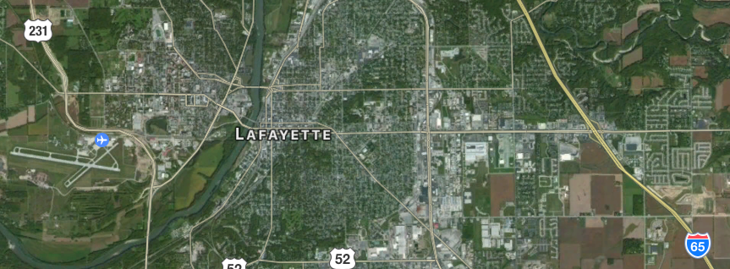
Memory sizes to scale
1 TB hard disk
8 GB DRAM
8 MB L3

Slide 12
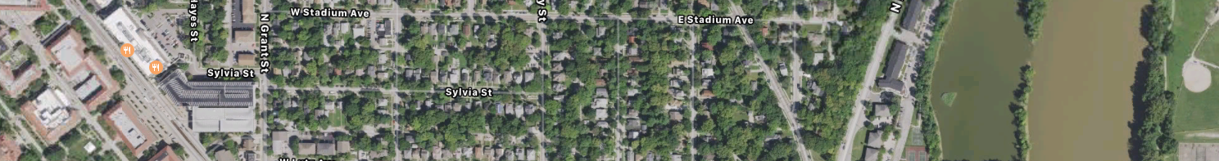
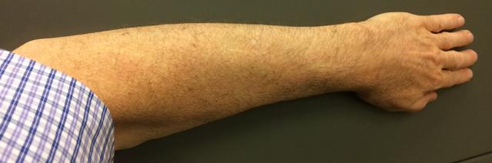
Memory sizes to scale
1 TB hard disk
8 GB DRAM
8 MB L3
64 KB L1
2 MB L2
512 Bytes
Notes:
This is the map your fellow Boilermakers are learning as they fly overhead so that can navigate our planet.
Abū Rayḥān Muḥammad ibn Aḥmad Al-Bīrūnī was first to write about this type of map.
Properties: (1) all points are at proportionately correct distances from the center point and (2) all points are at the correct direction, or azimuth, from the center point.
All shortest paths from KLAF to anywhere are radial, straight lines.

Slide 13
Hierarchy level extremes
Highest level: registers, yes but
Special level because movement into and out of this level is triggered by the user program via load and store instructions
Lowest level: slowest and largest memory that is considered part of the computer
Today, most often a disk; tomorrow, Flash?
Could be a robotic tape library, though
Could be cloud storage

Slide 14
Assignment
Read text chapter 13 on virtual memory
Read ahead chapters 14, 15 on input/output

Slide 15
CS250 Lecture 32 – Cache
2015.11.03
Some computers run my programs. I think they're ok.
If they don't run my programs quickly, I just walk away.
They just read and write DRAM? Then they can't have my bytes.
(That's right!)
Computers with an L1 cache are always “Mr. Right.”
with apologies to Madonna - Material Girl (1985)
Notes:
https://www.youtube.com/watch?v=6p-lDYPR2P8 Official music video for Material Girl.

Slide 16
Operation of the memory hierarchy
Register file
L1 (level 1) cache
L2 cache
L3 cache
Main memory
Disk(s) and/or SSD
Remote storage – remote in time
and/or location (e.g., the “Cloud”)
Movement of bits between registers and L1 is by LOAD/STORE instructions
Transfer size = CPU register size
Movement of bits between these hierarchy levels is managed entirely by hardware
Transfer size = L1 block size
Transfer size = L2 block size
Transfer size = L3 block size
Transfer size = Page size
Movement of bits in/out of this level managed by Operating System
Transfer size = K bytes
Movement of bits in/out of this level managed by various means
Copy/write arrows between levels are thinner at higher levels to show block size reduction necessary as access speed increases

Slide 17
The Block
The “chunk of bits” that moves between to adjacent levels is called a block, generically
For efficiency, block size is a power of 2 multiple of the size of a processor register
Block size is larger lower in the hierarchy
Blocks have different common names because the memory hierarchy developed over may years: cache line, main memory page, …

Slide 18
Three Rules of the memory hierarchy
The lowest level in the hierarchy is the ultimate repository for all information long-term
A level above is provided a copy of information from the level below when the level above cannot satisfy a processor request
When the processor stores (writes information into the top level), that change must eventually propagate down the levels to maintain Rule 1. (Propagation is transparent to user programs.)

Slide 19
Four key hierarchy design questions
Q1: Where can a block be placed?
Q2: How is a block found?
Q3: Which block should be replaced on a miss?
Q4: What happens on a write?
These questions nicely map out the design space for memory hierarchy
The answers to these design quesitons affect hardware performance and inform software best practices

Slide 20
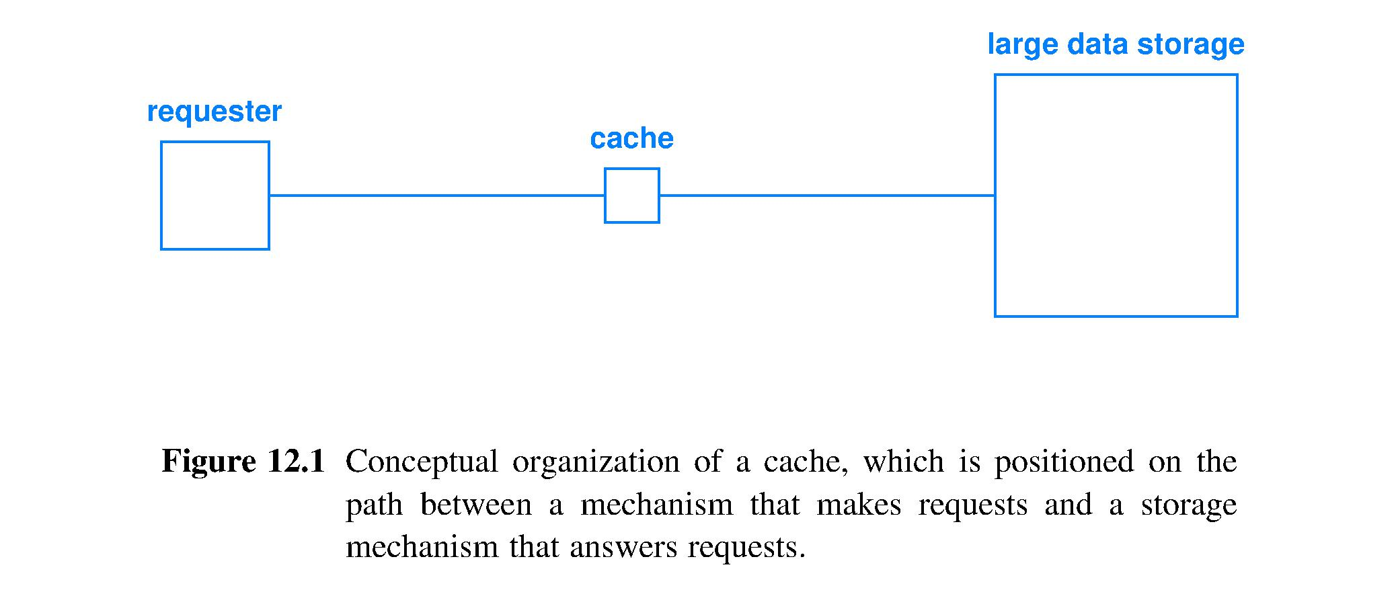
Caching
Key concept in computing
Used in both hardware and software
Memory caching can strongly reduce the Von Neumann bottleneck by reducing the time spent making memory accesses

Slide 21
Cache characteristics
Fast: the characteristic of principle interest
Small: the unavoidable characteristic; likely cannot hold every desirable item
Active: uses simple, fast hardware to make decisions about which items to store
Transparent: invisible to both requestor (say, CPU) and the slower, larger memory
Automatic: operation is entirely controlled by the sequence of addresses accessed and the access type (read, write)

Slide 22
Cache operation
CPU executes fetch, LOAD, or STORE, sending an address to cache; cache searches using address, then either
HIT: cache has a copy of the bit string in main memory and fetch/LOAD/STORE is processed on this copy, or
MISS: cache does not have a copy of the bit string; must remedy this deficiency, then process fetch/LOAD/STORE
HIT and MISS occur with a measurable average frequency, or rate, for a program
HIT and MISS each take a typically fixed amount of time: hit time and miss penalty

Slide 23
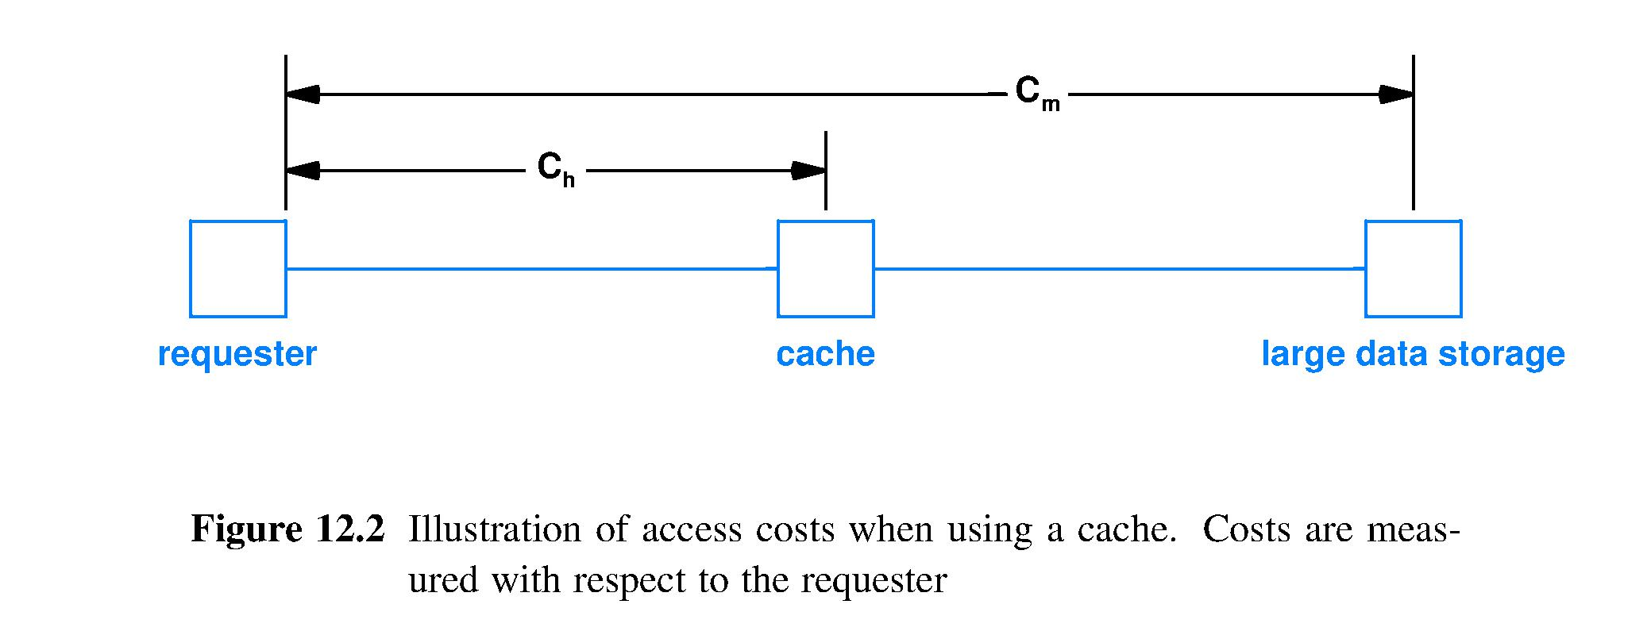
Memory hierarchy performance equations
Average memory access time model = Hit rate x Hit time + Miss rate x Miss Penalty = r C_{h} + (1-r)C_{m}
Memory request goes both to cache and to “large data storage”; if HIT then cancel request to storage, else wait for storage to process the request

Slide 24
Simple cache idea
Cache: a small, fast memory
X4 |  | X4
X1 |  | X1
Xn-2 |  | Xn-2
Xn-1 |  | Xn-1
X2 |  | X2
 |  | Xn
X3 |  | x3
Cache before
reference to Xn
Cache after
reference to Xn
Reference to Xn causes a cache miss that forces the cache hardware to fetch Xn from memory and insert it into the cache.

Slide 25
How do we find an item in cache?
One answer: Design exactly one place in the cache for each word in memory; called direct mapped
Memory access is frequent; so Amdahl’s Law says the mapping should be very fast, so use
(Memory block address) mod (cache size in blocks)
where # cache blocks = 2^{k} so that mod function is just the low-order log₂(cache size in blocks) bits of memory block address
Cache block size is a power of 2 number of consecutive memory locations; that number chosen to enhance memory performance

Slide 26
Cache addressing example, 32-bit address
Let cache have 1024 blocks each containing 4 32-bit words, thus
Index (pointer to a block) requires 10 bits
Byte offset (pointer to one byte within a block) requires 4 bits
Tag field gets all remaining bits
Address fields (showing bit positions) of this cache
31 30 … 15 14 13 … 5 4 3 2 1 0
Tag
Index
Byte offset

Slide 27
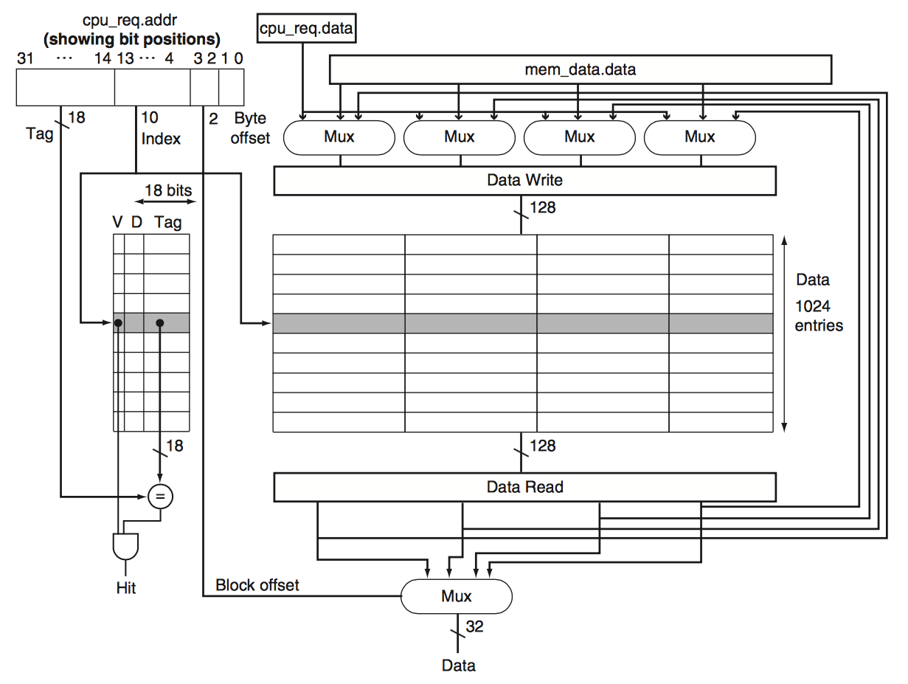
1024-block direct-mapped cache with 4-word blocks

Slide 28
Is this the item we are looking for?
A location in memory is uniquely identified by its address
Only low-order address bits are used to place item in cache, so use high-order bits to tag each block, yielding a unique combination
Corner case: cache start up. Need to recognize when cache contents are meaningless; add valid bit
TAG
TAG
TAG
TAG
TAG
TAG
TAG
TAG
V
V
V
V
V
V
V
V
000
001
010
011
100
101
110
111

Slide 29
Algorithm for direct-mapped cache access
Given: a memory address, A
Function: access word at address A
Method:
Extract tag t, index b, and offset o from fields in address A
If ( tag at block b matches t && Valid_bit == true) {
Use o to select word and deliver to CPU } Else { /* update cache block destroying current block contents */ Fetch block containing address A from some level below Write block in cache slot b /* overwrites existing content */ Set tag of slot b to t Set Valid=true Use o to select word within block and deliver to CPU }

Slide 30
Cache operation example
Initial state of cache after power on.
Index | V | Tag | Data
000 | N
001 | N
010 | N
011 | N
100 | N
101 | N
110 | N
111 | N

Slide 31
Cache operation example
Try to access address (10110_{two}) but cache MISS.
Index | V | Tag | Data
000 | N
001 | N
010 | N
011 | N
100 | N
101 | N
110 | N |  | (Contents not valid, so MISS; bring in data from memory)
111 | N

Slide 32
Cache operation example
After MISS of address (10110_{two}) due to NOT VALID.
Index | V | Tag | Data
000 | N
001 | N
010 | N
011 | N
100 | N
101 | N
110 | Y | 10_{two} | Memory (10110_{two})
111 | N

Slide 33
Cache operation example
Try to access address (11010_{two}) but again not valid miss.
Index | V | Tag | Data
000 | N
001 | N
010 | N |  | (Also a not valid block; MISS; bring in data)
011 | N
100 | N
101 | N
110 | Y | 10_{two} | Memory (10110_{two})
111 | N

Slide 34
Cache operation example
After handling a miss of address (11010_{two}).
Index | V | Tag | Data
000 | N
001 | N
010 | Y | 11_{two} | Memory (11011_{two})
011 | N
100 | N
101 | N
110 | Y | 10_{two} | Memory (10110_{two})
111 | N

Slide 35
Cache operation example
After handling a miss of address (10000_{two}).
Index | V | Tag | Data
000 | Y | 10_{two} | Memory (10000_{two})
001 | N
010 | Y | 11_{two} | Memory (11011_{two})
011 | N
100 | N
101 | N
110 | Y | 10_{two} | Memory (10110_{two})
111 | N

Slide 36
Cache operation example
After handling a miss of address (00011_{two}).
Index | V | Tag | Data
000 | Y | 10_{two} | Memory (10000_{two})
001 | N
010 | Y | 11_{two} | Memory (11011_{two})
011 | Y | 00_{two} | Memory (00011_{two})
100 | N
101 | N
110 | Y | 10_{two} | Memory (10110_{two})
111 | N

Slide 37
Cache operation example
Now address (10010_{two}); block is valid but tag MISMATCH.
Index | V | Tag | Data
000 | Y | 10_{two} | Memory (10000_{two})
001 | N
010 | Y | 11_{two} | Memory (11011_{two})
011 | Y | 00_{two} | Memory (00011_{two)}
100 | N
101 | N
110 | Y | 10_{two} | Memory (10110_{two})
111 | N

Slide 38
Cache operation example
Now address (10010_{two}); replace block contents with
that of address (10010_{two}).
Index | V | Tag | Data
000 | Y | 10_{two} | Memory (10000_{two})
001 | N
010 | Y | 10_{two} | Memory (10010_{two})
011 | Y | 00_{two} | Memory (00011_{two)}
100 | N
101 | N
110 | Y | 10_{two} | Memory (10110_{two})
111 | N

Slide 39
Improving cache performance
Cache performance model is embodied by Average memory access time = Hit time + Miss rate x Miss penalty
Cache optimizations can usefully be organized according to which term and/or factor of the average_memory_access_time is improved
Reducing the miss rate
Reducing the miss penalty
Reducing the time to hit
Using models, using math, to formally describe a system helps avoid overlooking ways to improve
Supports “Never, …, never give up!” design strategy

Slide 40
Instruction and data cache designs
Instruction accesses mostly sequential
Default_next_instr._addr. is the most common because branch/jump/jsr instructions a minority
Prefetching along the default path pays off nicely
Data accesses less predictable
Less locality of reference
Prefetching payoff is less
Small cache size accentuates these differences
Cache designs should be evaluated by testing on actual workloads when possible

Slide 41

Memory hierarchy split and addressing
IF
stage
MEM
stage
Reg name
L1 Data cache
L2 Data cache
Unified Instr. & Data L3 cache (von Neumann)
Unified main memory
Unified local disk(s) and/or SSD
Unified remote storage, remote in time (a massive and slow technology) and/or spatial location (the “Cloud”)
L1 Instr. cache
L2 Instr. cache
Unified Instr. & Data L3 cache (von Neumann)
Unified main memory
Unified local disk(s) and/or SSD
Unified remote storage, remote in time (a massive and slow technology) and/or spatial location (the “Cloud”)
Memory address
Addressed using
Inode, URL, etc.

Slide 42
Cache size
Experiments show cache hit ratio increases with increase in cache size
But also costs of hit (access time) and cost of miss tend to increase with cache size
Also, some programs have great hit ratios with small cache, some need big cache to get good hit ratios
Conclusion: experiments are helpful essential

Slide 43
Improving cache performance
Block is the unit of information transferred between levels in the hierarchy
Moving a consecutive multiword block often takes same time as 1 word; parallelism
Reading from the memory hierarchy is easy; writing is harder
Hierarchy Rules 1 & 2 “bubble up” information to faster levels, so reads access faster levels
Rule 1 demands that writes access the slowest level, a serious obstacle to performance
Rule 3 crucial to making writes faster

Slide 44
How to handle writes with caching
Write-through strategy: CPU writes into the cache and the write continues through the cache to the lowest level of the hierarchy
Satisfy Rule 3 of the Memory Hierarchy right now
Costs right now the time to write to a slow level; likely stalls CPU
Write-back strategy: CPU writes into cache now. Later when forced to do so, the cache writes down a level, and so on
Write-back strategy procrastinates on satisfying Rule 3
Writes complete at the speed of the cache, like reads
Push off cost of writing to the slow, low level as far into the future as possible; CPU not involved, so no direct CPU stall
Can “absorb” several writes to one cache block that are written back as a single operation, eventually, saving costs that multiple write-through actions would incur
Must write program output to lowest level, else program fails

Slide 45
Writing changes later- Write Back
Must mark changes as you go
At minimum requires a single bit for each cache block (could label at finer granularity)
Traditionally this bit is called the dirty bit
When a cache miss will force replacement of of a dirty block, that block must first be written back (to the next lower memory level)
Enforces Rule 3 of the Memory Hierarchy per its “eventually” clause

Slide 46
Write-back cache with 4-word blocks

Slide 47
Set-associative cache
When cache maps any block to 1 place, then memory accesses with same index but different tags conflict in cache block with their index
Revise circuit to let each index hold more than 1 block, called a set-associative cache
When a new block is to be brought in to full set there is now a choice of which block currently in the set to replace
Must include a circuit to make this choice fast

Slide 48
Make this cache 3-way associative

Slide 49
Make cache bigger via associativity
Example, replicate storage area 3x so each block has 3 available placements
Why number of placements != 2^{k} ? Associative storage areas are not separately addressed; they are only tag matched
3-way associative requires 3 tag match circuits, , not 1
=
VDTag Data
=
=
=

Slide 50
Fully associative cache, no conflict
Compulsory miss reduction is limited by how wide an interface a given memory technology supports
Capacity miss reduction limited by affordability of a larger cache (circuit $ and heat factors)
Conflict misses can be avoided (eliminated) by a design that lets any block be placed anywhere in cache
Corresponds to an Index field of zero bits; only have tag field and offset field
Use fully associative cache when
Miss penalty is huge, and
Can afford the time to agonize over which block to replace when, not if, that time comes

Slide 51
Disadvantage of associative cache
Must make a choice when replacing a block
To achieve acceptable speed choice-making by hardware is required
What algorithm should circuit implement?
Optimal choice is to replace that block in the set having its next use farthest into the future (delay paying the cost of re-loading a block into cache as much as possible)
Optimal choice is a tough algorithm even for software, certainly problematic for hardware

Slide 52
More practical replacement algorithms
Least recently used (LRU) uses measurable past as a proxy for prediction of the future
“Least” easy to track in hardware for sets with just 2 blocks, but much harder for >2 blocks per set
Try approximation algorithms instead, such as
Not Recently Used (NRU)
Add a “Referenced” bit to each cache block; clear all such bits periodically, then set whenever a block is referenced (used)
Replace block with lowest category value in this table
Block category | Referenced? | Dirty?
3 | Y | Y
2 | Y | N
1 | N | Y
0 | N | N
Don’t forget the hardware for tie-breaker capability
Notes:
To do LRU for more than 2, we must build a ranked list purely in hardware.
Circuit gets big and slow fast :^)

Slide 53
More thoughts
Two more “easier” (fast) algorithms
First-in, first-out
Pseudo-random (!)
All algorithms can work well at times, and all can fail totally at times
Simulation on real workloads is valuable to designers
Cache-aware compiling for a given platform can deliver performance value
Your complete computing platform determines your experience

Slide 54
The 3 C’s of cache miss categories
Miss categories
Compulsory miss (also called cold-start miss or first-reference miss): name for the miss that must occur on the first access to a block
Capacity miss: misses caused because cache cannot hold all blocks ever accessed by a program
Conflict miss: if there is any restriction on where a block can be placed in cache, then in addition to compulsory and capacity misses, conflict misses occur when too many accessed blocks map to the same cache location
3 C’s provide helpful guidance for cache designers seeking to improve performance by reducing misses

Slide 55
Playing in the cache design space
Increase/decrease (in/de) size of offset field
Increase/decrease words in block, so decrease/increase compulsory misses to extent accesses are sequential-ish
Increase hardware interface between cache and both CPU and memory
In/de (size of index field + size of offset field)
In/de total cache size, so de/in capacity misses & in/de cache cost
In/de cache circuit size which in/de access time
Increase/decrease cache associativity
Decrease/increase conflict misses
In/de cache circuit size & in/de access time

Slide 56
Summary
Caching is a fundamental performance technique
Large design space with many optimization techniques
Simulation guides design quantitatively
For programmers to maximize caching benefit
Group related data items into adjacent blocks
Perform all operations on a data item before moving on to another data item

